Slide 1
Moving from Data Collection to Action:
Improving Patient Access to SDOH Resources
November 2, 2023
National Webinar Series: Part 1 of 4
Brought to you by the National Training and Technical Assistance Partners (NTTAPs) of the SDOH Academy

Slide 2
Housekeeping
All participants are muted on entry to limit background noise​
Use the Q&A or chat box to ask a question during the session​
This webinar is being recorded and materials will be emailed to participants​
We would love to hear your feedback – please fill out our brief evaluation at the end of this session!

Slide 3
The Social Determinants of Health (SDOH) Academy
The SDOH Academy is a HRSA-funded virtual training series designed to help staff from health centers, health center controlled networks, and primary care associations develop, implement, and sustain SDOH interventions in their clinics and communities.
The power of The SDOH Academy is that it does not focus on a single intervention. Instead, multiple HRSA-funded national training and technical assistance partners work together to offer a coordinated curriculum on multiple community-based SDOH interventions.
To learn more, visit: https://sdohacademy.com/

Slide 4
National Training and Technical Assistance Partners (NTTAPs)
Maximize impact of Health Center Programs
Increase access to high-quality comprehensive primary health care for underserved populations
Support HRSA awareness of issues impacting health centers and special populations
Support HC to identify and implement evidence based and promising practices
Leverage HC shared experience and data to improve health outcomes for patients
To learn more, visit: https://bphc.hrsa.gov/technical-assistance/strategic-partnerships/national-training-technical-assistance-partners

Slide 5
National Training and Technical Assistance Partners (NTTAPs)

Slide 6
Today’s Presenters
Cloé Destinoble, MPH
Project Manager,
Equitable Health and Wellbeing
NACHC
Jamie Blackburn, MPA
Senior Program Manager
Corporation for Supportive Housing
Sonia Deal, RN, MSN/MHA, CHCEF, PCMH CCE
Vice President of Community Health and Engagement
Affinia Healthcare

Slide 7
Learning Objectives
Understand factors that limit or prevent access to needed health services for priority patient populations
Describe the value of prioritizing enabling services to improve health outcomes, including utilizing Community Health Workers (CHW) to address non-medical health needs
Incorporate strategies to leverage SDOH screening data to establish effective partnerships and referral networks

Slide 8
When did this conversation begin?
“The last time I checked my textbooks, the specific therapy for malnutrition was in fact, food.”
Jack Geiger, 1965
https://en.wikipedia.org/wiki/H._Jack_Geiger

Slide 9
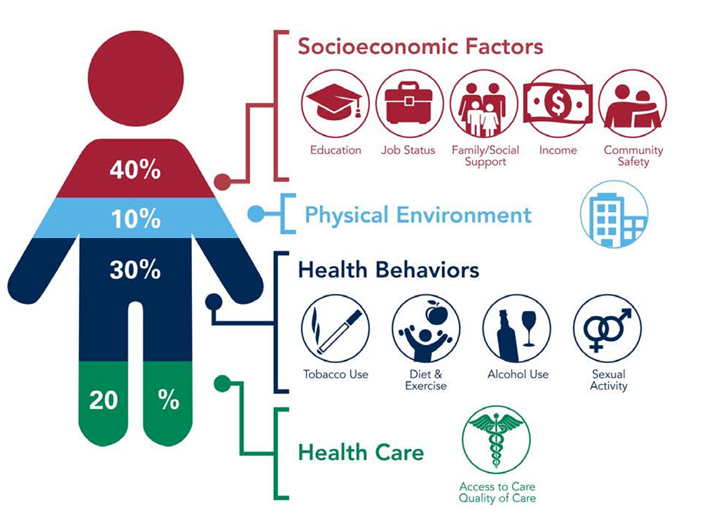
Social Determinants
(or Social Drivers)
of Health
American Hospital Association – Addressing Social Determinants of Health, 2018

Slide 10
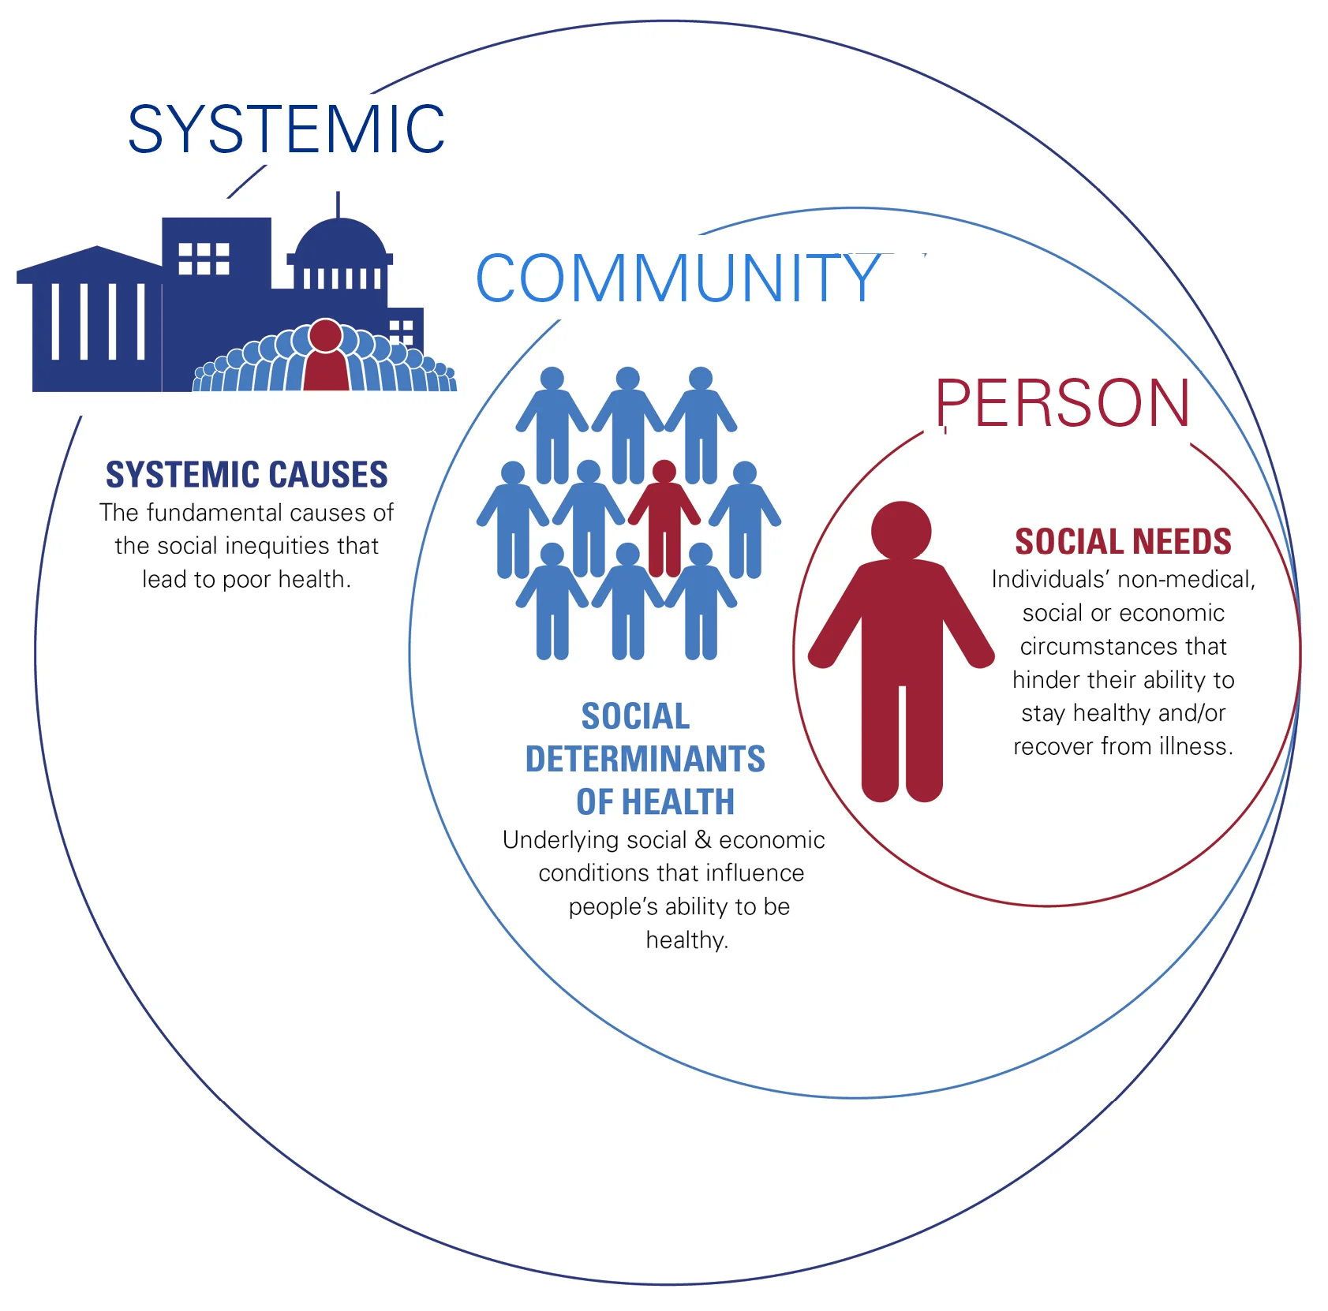
Person: Unstable Housing, Food Insecurity, Lack of Transportation Options, Loneliness, Unsafe Home Environment
Community: Food Deserts, Lack of Affordable Housing, Community Violence, Inadequate Public Transit
Systemic: Inequities such as racism, sexism, ageism, generational poverty, environmental injustice
American Hospital Association: Societal Factors That Influence Health

Slide 11
Advancing Health Center Excellence Framework
Population needs assessment and management
Community needs and resource mapping
Resource allocation
Community partnerships and collaborations
Track and close social service referral loops
Advancing Health Center Excellence Framework Fact Sheet

Slide 12
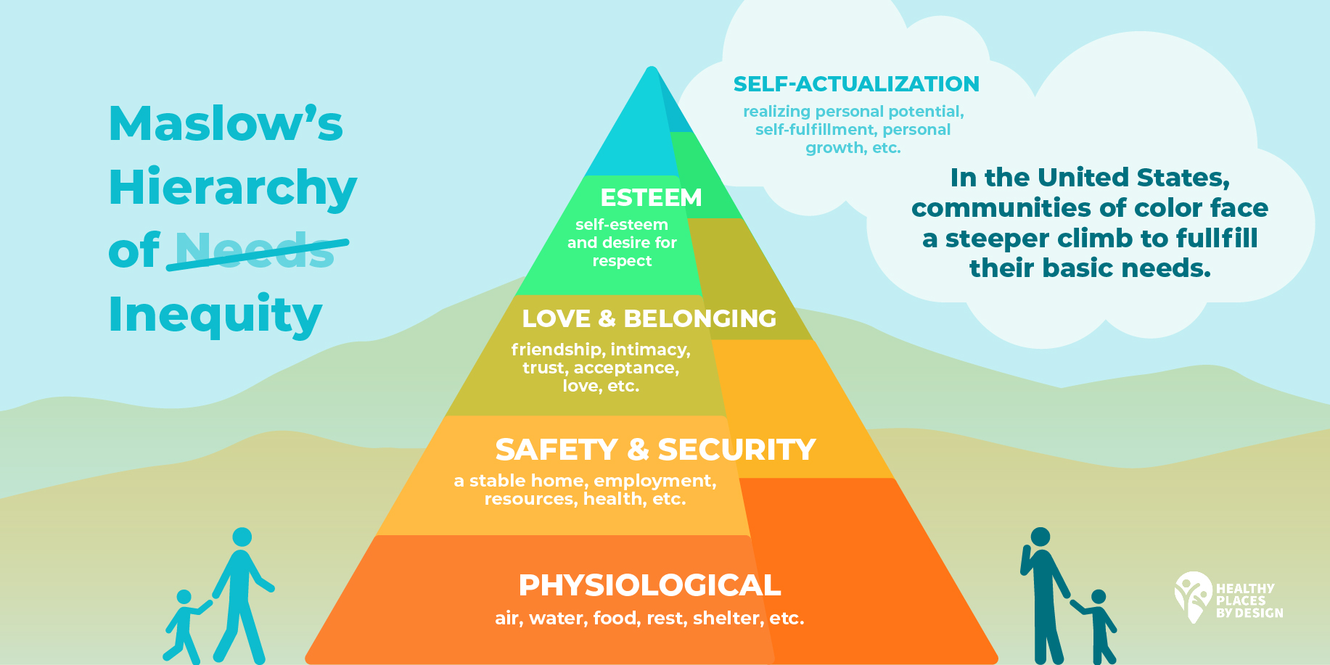
Blog Post: Healthy Places by Design

Slide 13
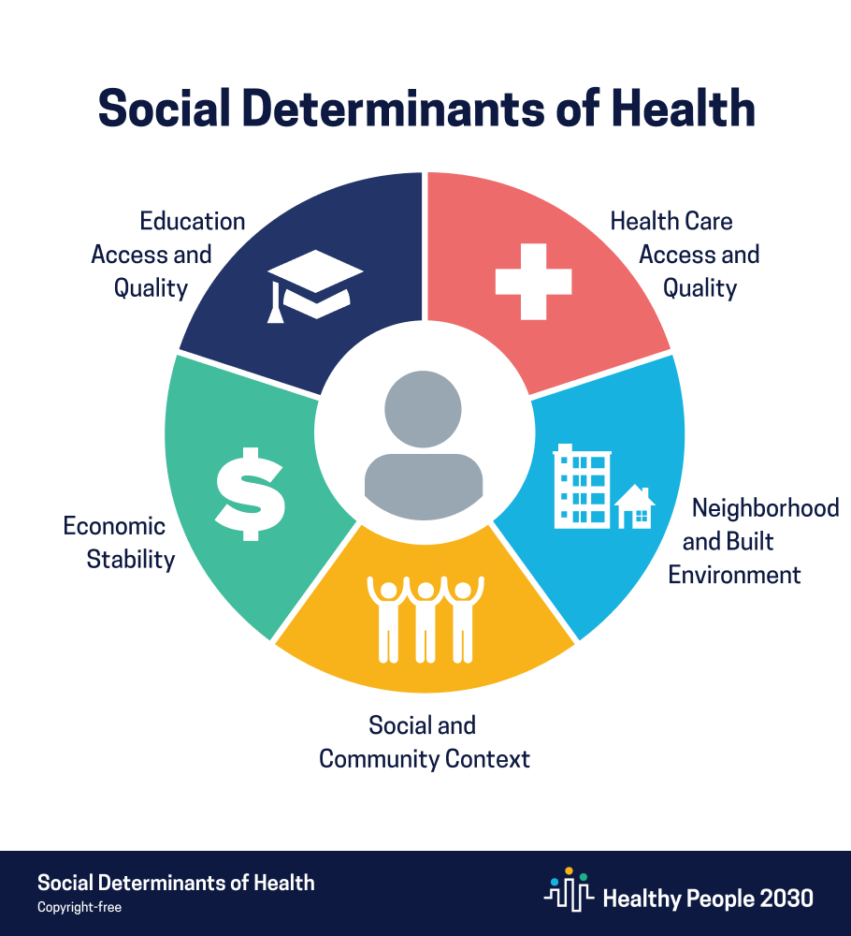
Healthy People 2030: SDOH
Conditions in the environments where people:
are born, live, learn, work, play, worship, and age
that affect a wide range of:
health, functioning, and quality-of-life outcomes and risks

Slide 14
Neighborhood & Built Environment
Health & Safety Promotion
Environmental Health
Transportation
Physical Activity
Injury Prevention
Safe/Affordable Housing

Slide 15
Neighborhood & Built Environment
Safe/Affordable Housing Objectives
Reduce % of income spent on housing through policy expansion
Reduce exposure to lead-based paint in older housing
Reduce # of homes and residential buildings with entrance stairs to increase accessibility

Slide 16
SDOH Spotlight: Housing as a Driver of Health

Slide 17
By the Numbers – UDS 2022
94% of FQHCs have or plan to implement an SDOH screening tool
1,357,683 total patients experiencing homelessness
521,299 patients screened positive for housing insecurity
2,722.66 FTE Outreach Workers employed (2 per HC)
2,310.60 FTE Community Health Workers (1.38 per HC)
2,377,210 Patients received Enabling Services
Source: 2022 UDS National Data Table 5: Staffing and Utilization
FACT SHEET: Biden-Harris Administration Announces Plan to Prevent and End Homelessness | The White House
Notes:
Jamie

Slide 18
FQHC Patients Experiencing Housing Instability or Homelessness, UDS 2021
Notes:
Jamie

Slide 19
Tell us in the chat:
How is your health center or organization currently addressing the SDOH needs of your patients?
Notes:
Jamie

Slide 20
How Neighborhoods Impact Health
Space for exercise and recreation free from crime, violence and pollution.
Access to grocery stores selling fresh produce and the absence of “Food Deserts”.
Access to employment opportunities and public resources including transportation, an effective police force and good schools.
Concentration of substandard housing in less advantaged neighborhoods further compounds racial and ethnic as well as socioeconomic disparities in health.

Slide 21
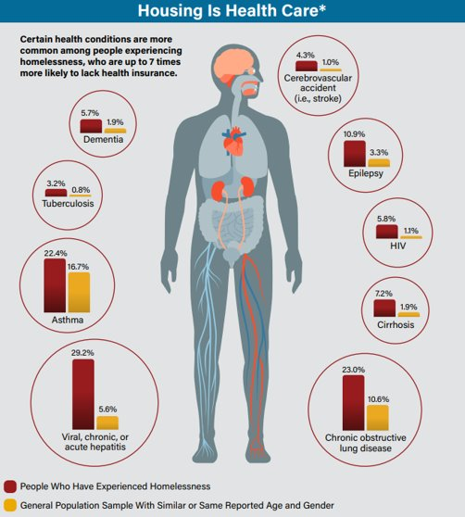
Housing as a Determinant of Health
Housing is one of the most basic and powerful social determinants of health
High housing cost burden is associated with negative health outcomes including higher rates of mental distress and HIV prevalence.
Healthy People 2030 objectives aim to reduce the proportion of rent burdened families.
Baxter, Andrew J., et al. "Effects of Housing First approaches on health and well-being of adults who are homeless or at risk of homelessness: systematic review and meta-analysis of randomised controlled trials." J Epidemiol Community Health 73.5 (2019): 379-387.​
Notes:
Jamie

Slide 22
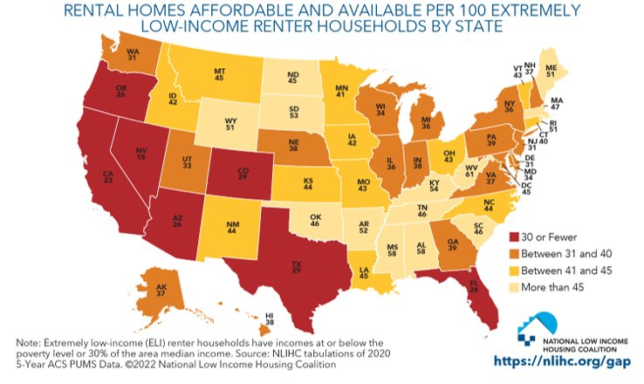
The US Housing Crisis
Only 1 in 4 individuals who need rental assistance can access it
National average wait time is 2.5 years among those who were successfully housed.
53% of agencies have closed waiting lists
Notes:
Jamie

Slide 23
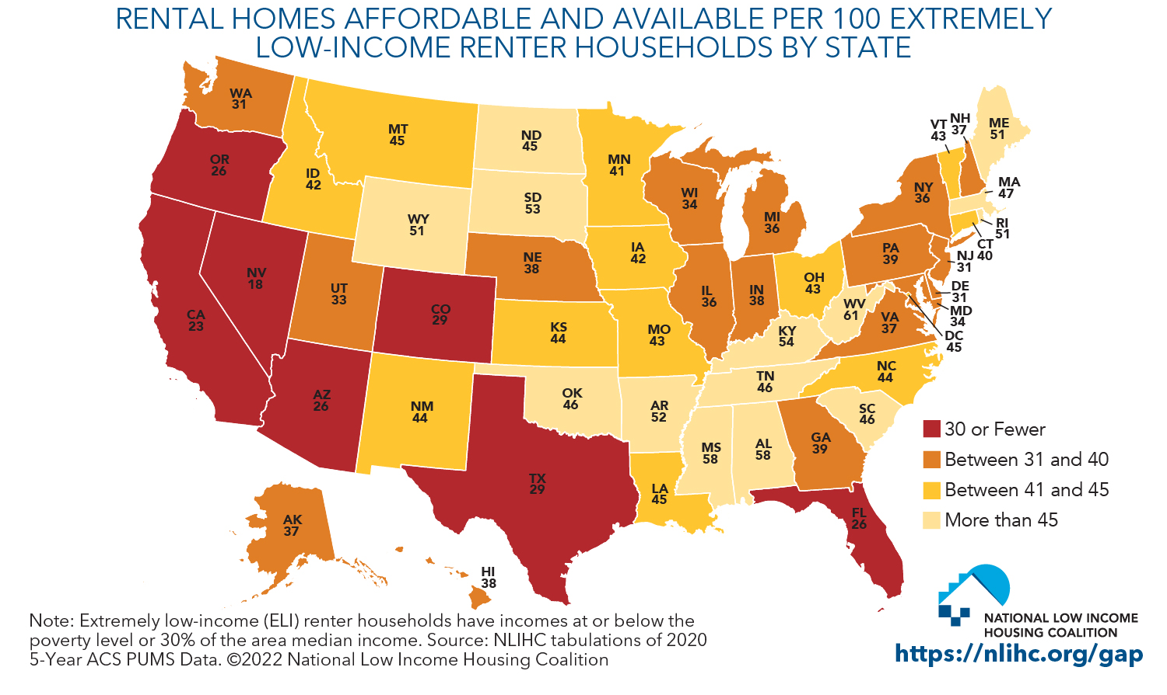
Housing is not Funded as an Entitlement
Unlike other parts of the social safety net — such as social security — affordable housing is not an entitlement.
Congress funds rental assistance through annual appropriation and must provide sufficient funding for each program with adjustments for inflation.
Insufficient resources to cover program costs can result in a reduction of rental assistance, which already fails to meet the need.

Slide 24
The Wrong Pocket Problem
Understanding SDOH creates the wrong pocket problem. We know what works to improve health, but we can’t use health care funding to assist with
Food
Housing
Education
We need new partners and new resources to address to address these issues
Notes:
http://www.urban.org/sites/default/files/alfresco/publication-pdfs/2000427-Solving-the-Wrong-Pockets-Problem.pdf
The technology allows us to pull together huge sources of data to determine what impact health. Some of it we can address, as a health care delivery system. Other piece we cannot. We need NEW PARTNERs and that is what today is about.
Growing focus on population health- where are there large scale challenges in your communities?

Slide 25
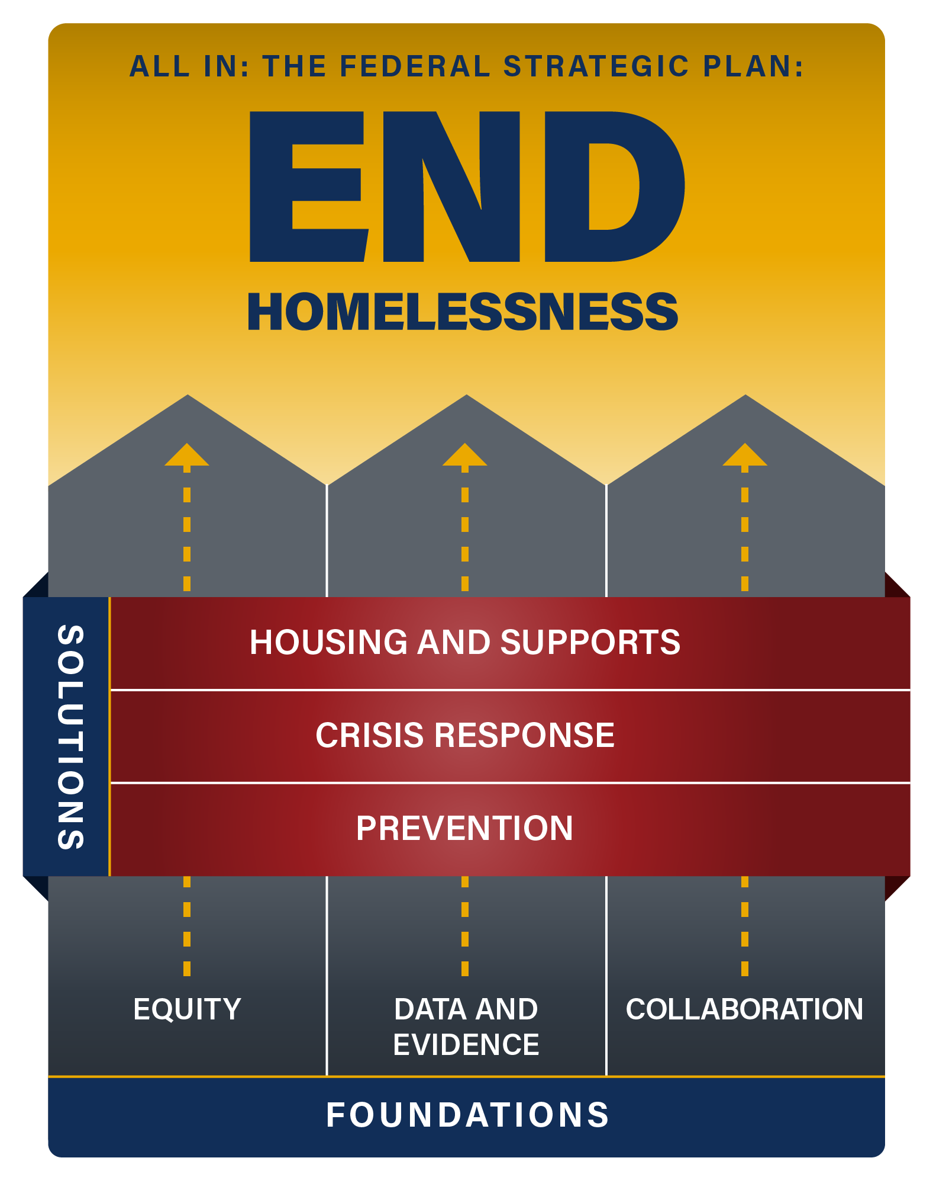
All In: Federal Strategic Plan to Prevent and End Homelessness
Strategy 1: Maximize the use of existing federal housing assistance
Action Step:
Encourage partnerships between providers of housing, aging and disability services, and health care
All_In.pdf (usich.gov)
$486m in in new grant funding distributed for rural and unsheltered homeless in 2023
Fact Sheet: HUD Announces $486 Million in Grants and $43 Million for Stability Vouchers to Address Unsheltered and Rural Homelessness | HUD.gov / U.S. Department of Housing and Urban Development (HUD)
Notes:
Jamie

Slide 26
The Role of Community Health Workers (CHWs) in Addressing SDOH Needs

Slide 27
Who Are Community Health Workers (CHW)?
A Community Health Worker (CHW) is a trusted member of the community who empowers their peers through education and connections to health and social resources.
To learn more, visit: https://mhpsalud.org/our-programs/community-health-workers/

Slide 28
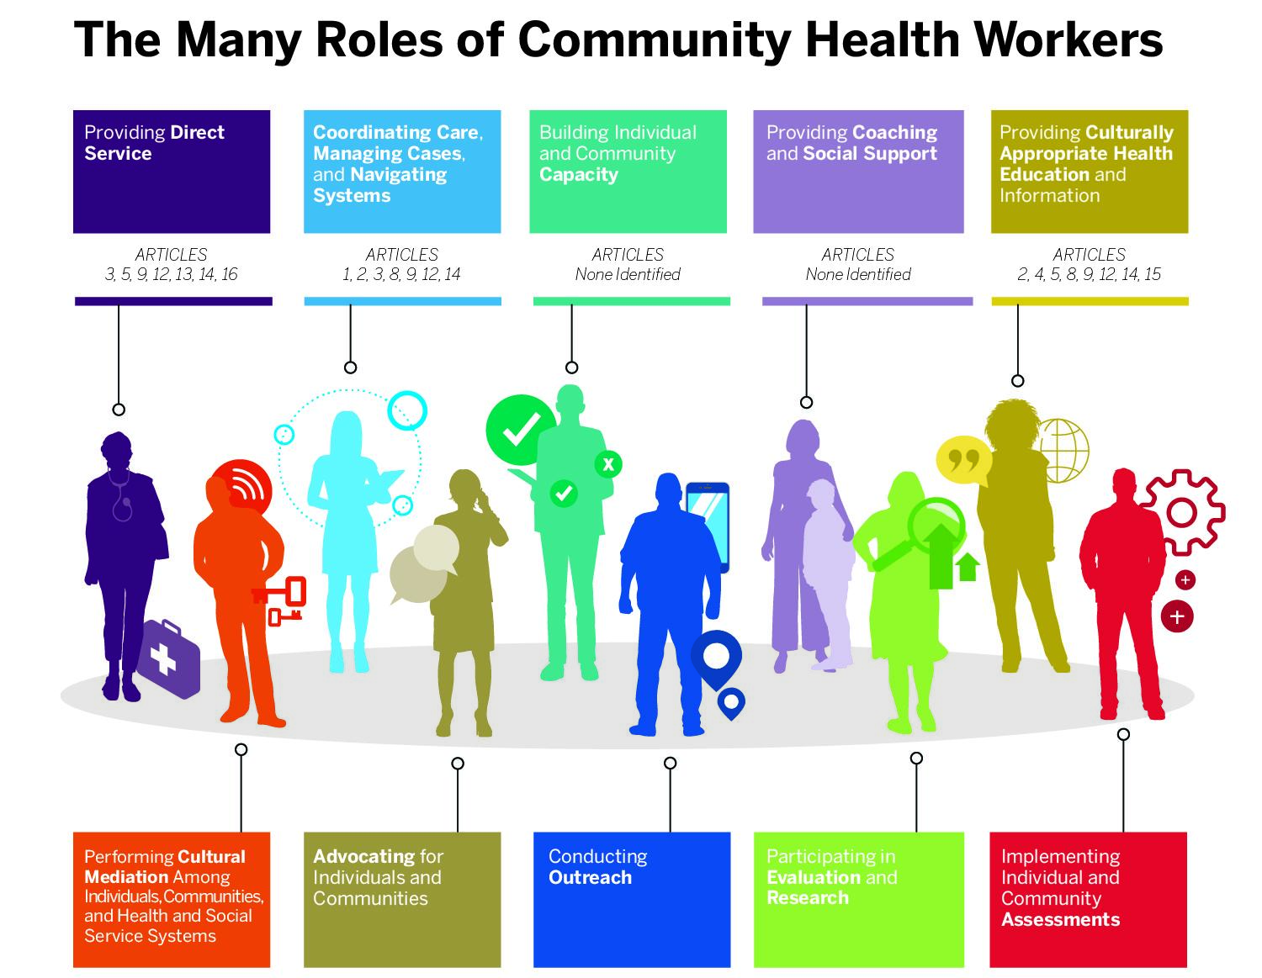
Source: CHW-ROLES.jpg (radx-up.org)

Slide 29
Health Center CHWs are Vital to Addressing SDOH Needs
Cost-effective for the community at large. Multiple ROI analyses have shown positive returns for every $1 spent.
CHWs are presently being leveraged for SDOH Screening and Referral efforts at health centers
This role can be expanded for the purpose of building and maintaining referral networks addressing SDOH Needs.
Notes:
Jamie
A Community Health Worker (CHW) is a trusted member of the community who empowers community members through education and connections to health and social resources. They have proven to be successful at increasing health outcomes for their communities they serve because they have a deep understanding of the people they serve. F

Slide 30
Referral Networks and Partnerships to Address SDOH Needs

Slide 31
Individual vs. Community Impact
Improvements to population health on a broad scale can only be achieved when we have the will to move even further upstream to change the root of community conditions. ​

Slide 32
Checking in… Share your experience with cross-sector partnerships. What have you learned?

Slide 33
Key Partnerships: The Homeless Response System in your Community
Notes:
Jamie

Slide 34
What is a Continuum of Care (CoC) in the Homeless and Housing Sector?
A regional or local planning body that coordinates federal housing and services funding for homeless families and individuals
Functions of a CoC
Organize all homeless providers around a single table
Outreach, assessment, prioritization and referral for resources (coordinated entry).
Operates a database focused on homelessness (HMIS)
Conducts the annual Point in Time (PIT) count and tracks Housing Inventory (HIC)
Coordinates funding opportunities
Find Your Local CoC
Notes:
CoCs are tasked to can track and manage the homeless community in their area. One of most important activities entrusted to CoCs is the biannual count of the homeless population and an annual enumeration of emergency systems, transitional housing units, and beds that make up the homeless assistance systems. These counts provide an overview of the state of homelessness in a CoC, and offer the information necessary to redirect services, funding, and resources as necessary. The CoC also manages these services, offering both prevention strategies and homeless assistance programs to assist those at-risk of or experiencing homelessness.

Slide 35
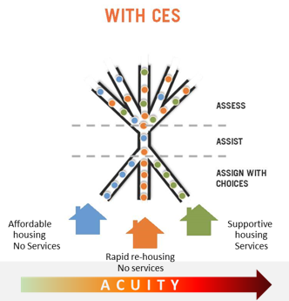
Accessing Housing Resources: What is Coordinated Entry (CE)?
Coordinated Entry is a process where housing resources funded by The Department of Housing and Urban Development (HUD) and administered by the local Continuum of Care (CoC) are distributed based on a locally defined set of priorities and a common assessment tool.
Each CoC determines how and who to prioritize based on local needs and goals.
Coordinated Entry Core Elements (hudexchange.info)
Notes:
Derek
Health Centers can find more information about the CoC in their area here.
A Coordinated Entry System (CES) allows persons experiencing homelessness and organizations providing housing to find each other.
Prior to CES, housing was accessed on a first-come, first-served basis.
With CES, housing is matched to individual needs and acuity.
The highest acuity, chronically homeless people will get supportive housing units that come with supportive services.
People who present with mid-level acuity will get rapid-rehousing, which provides short-term rental subsidies (3-6 mos) for an individual or family experiencing short-term homelessness to get back on their feet.
People with low-acuity will be directed to affordable housing units with no services.

Slide 36
Reminder about Competing Definitions of Homelessness
HUD maintains the most detailed, complex definition of homelessness and is recognized as the leading authority.
HRSA-supported Health Centers operate under the HHS definition, which can be summarized as a person “who lacks housing” according to section 330(h)(5)(A) of the Public Health Service Act.
More recent HRSA resources that define homelessness include page 89 of the HRSA Health Center Program Compliance Manual and the reporting instructions for homeless patients starting on page 41 of the UDS Manual.
Notes:
Jamie

Slide 37
Accessing CoC Housing Resources via Coordinated Entry
To be placed on the CoC wait list for housing a patient must be screened and complete an intake.
In some localities there is a "No Wrong Door" approach where all agencies can receive referrals and conduct the assessment/intake (Example: Wisconsin Balance of State CoC)
For others, there is a centralized process via 211 hotline or centralized organization. (Example: CT CAN 211 system)
Notes:
Jamie
In order for a patient/client to be placed on the wait list for housing, they must have received a VI-SPDAT screening and completed an intake.
Many localities utilize a "No Wrong Door" approach where all agencies can receive referrals and conduct the assessment and intake.
For other areas or regions, there is a centralized process via a 211 hot or centrally organized system

Slide 38
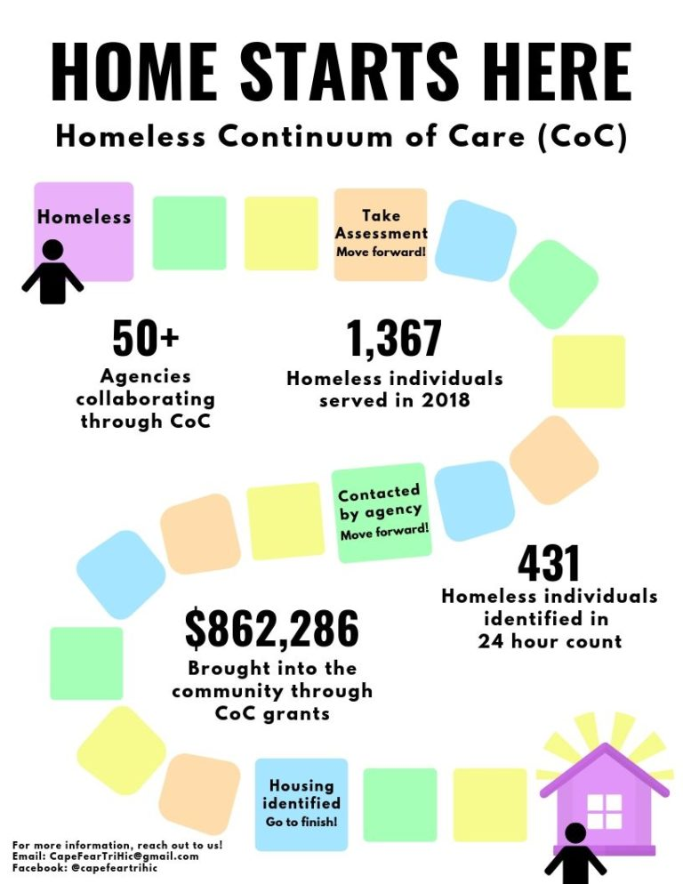
Answering your questions:
What is a health center's role in a continuum of care? ​
What roles and responsibilities could a health center have? ​
How do we make this more formalized than giving a phone number to call the CoC for housing screening?
Cape Fear, Delaware - Homeless Continuum of Care Outreach flyer

Slide 39
Becoming a CoC Access Point
Join your local CoC – and committees
Examine internal data on Non-Medical Drivers of Health to understand patient housing needs and barriers.
Understand local process for prioritization and referral to housing resources.
Collaborate to understand needs
- more access points?
- Is there funding to support?
Examine
capacity for screening and assessments:
- Staffing
- technology

Slide 40
Action Steps for Health Centers
Determine how your health center is using SDOH screening data to improve patient well-being
Develop or refine a plan for using SDOH data that is tailored to your community’s unique needs and resources
Identify a staff member to initiate and manage relationships with local service agencies
Ensure comprehensive referral procedures are in place for patients with defined SDOH needs

Slide 41
Questions?
Use the chat box or Q&A feature!

Slide 42
Special Presentation
Sonia Deal, RN, MSN/MHA, CHCEF, PCMH CCE
Vice President of Community Health and Engagement

Slide 43
SDOH ACADEMY webinar series
SONIA DEAL, RN, MSN, CHCEF, PCMH CCE
AFFINIA HEALTHCARE
VICE PRESIDENT OF COMMUNITY HEALTH AND ENGAGEMENT

Slide 44
Community Health Center (FQHC) in St. Louis, MO
8 clinical sites, including school-based health centers
5 health centers within 20 minute proximity of downtown St. Louis
Approximately 43,000 patients
approx. 8000 diagnosed with HTN
approx. 3600 blood pressure controlled
Notes:
Sonia

Slide 45
ROLE OF THE CHW
-Facilitating communication between community members and health and care organizations
-Building a trusting relationship with the community in which they represent, Helping people understand their health or social conditions
-Providing advocacy for those who need it
-Making home visits to high-risk patients, pregnant or nursing mothers, and the elderly
-Holding groups and individual meetings with people in the community
-Delivering health care information in a way that is easy to understand
-Providing informal counseling, Determining eligibility for health care plans
-Collecting data to inform future programs

Slide 46
CHW’S IN ACTION
Chronic Conditions
HIV Team
Foster Care Program
Affinia Healthcare CHW programming
Affinia Healthcare CHWs operate and focus on specific programs. These are areas/programs where those CHWs are embedded.
PRAPARE Assessments & SDOH
Medicaid Patients
Vaccine Clinic

Slide 47
DATA DRIVING PROGRAMS
PRAPARE AND DATA
PROGRAM
CLINICAL DATA
PRAPARE
FOOD
HOUSING
TRANSPORTATION
INCOME
UTILITIES
CHRONIC DISEASE PROGRAMMING
MOBILE FOOD MARKET
COLLABORATIONS WITH HOUSING AUTHORITY
UBERHEALTH
COLLABORATIONS WITH EMPLOYMENT AGENCIES
UTILITY ASSISTANCE PROGRAMMING

Slide 48
COLLABORATIONS AND PARTNERSHIPS
ST LOUIS PUBLIC HOUSING AUTHORITY
FIRE DEPARTMENT
INTERNAL HYPERTENSION CLINIC AND EDUCATION PROGRAM
ST LOUIS METROMARKET
YMCA
MISSOURI PRIMARY CARE ASSOCIATION
AMERICAN HEART ASSOCIATION
AMERICAN CANCER SOCIETY… AND MANY MORE

Slide 49
CHALLENGES
Data shaping
Data sharing
Partner roles
Sustainable funding

Slide 50
PEARLS
Determine data points and goal for data gathering and analysis
Utilize CHW at the beginning of the process for input and brainstorming
Define roles early
THINK OUTSIDE OF THE BOX

Slide 51
SUCCESSES
Blood pressure improvement
Screening and education programs for chronic disease
Community connection through unlikely sources
Initiation of utility assistance programs at FQHC
Direct link to other resources (housing, UberHealth transportation, etc.)

Slide 52
Contact Information: Sonia Deal sshanklin@affiniahealthcare.org

Slide 53
Questions?
Use the chat box or Q&A feature!

Slide 54
Part 2
Fostering a Healthcare Workforce for Today's Social Health Challenges
Dec 7, 2023 | 3-4:30 pm ET
Registration Coming Soon!

Slide 55
THANK YOU!
Please help us improve future sessions by completing our short evaluation.
https://www.surveymonkey.com/r/XKSZVKS

Slide 56
Attention Health Center Staff: Share your Voice on Training and Technical Assistance (TTA) Needs
Help HRSA/BPHC understand YOUR:
Health Center Role and Location
Specific TTA Needs
Preferred Ways to Receive and Participate in Training
Priority TTA Topics
Use this link or above QR code to complete your survey response.
This will take no longer than 15 minutes!
This project is supported by the Health Resources and Services Administration (HRSA) of the U.S. Department of Health and Human Services (HHS) as part of an award totaling $6,625,000 with zero percentage financed with non-governmental sources. The contents are those of the author(s) and do not necessarily represent the official views of, nor an endorsement, by HRSA, HHS, or the U.S. Government. For more information, please visit HRSA.gov.
Notes:
Take the needs assessment: https://www.healthcenterinfo.org/training-and-technical-assistance-needs-assessment/

